Slide 1

Artificial Intelligence for Games Week 1 – Introduction Steve Rabin
Please wear a mask in this course.
TAs: Jian Kia Phua, Brandon Hsu, Zak Stephenson, Keaton Sullivan, John Tseng, Andrew Roulst

Slide 2

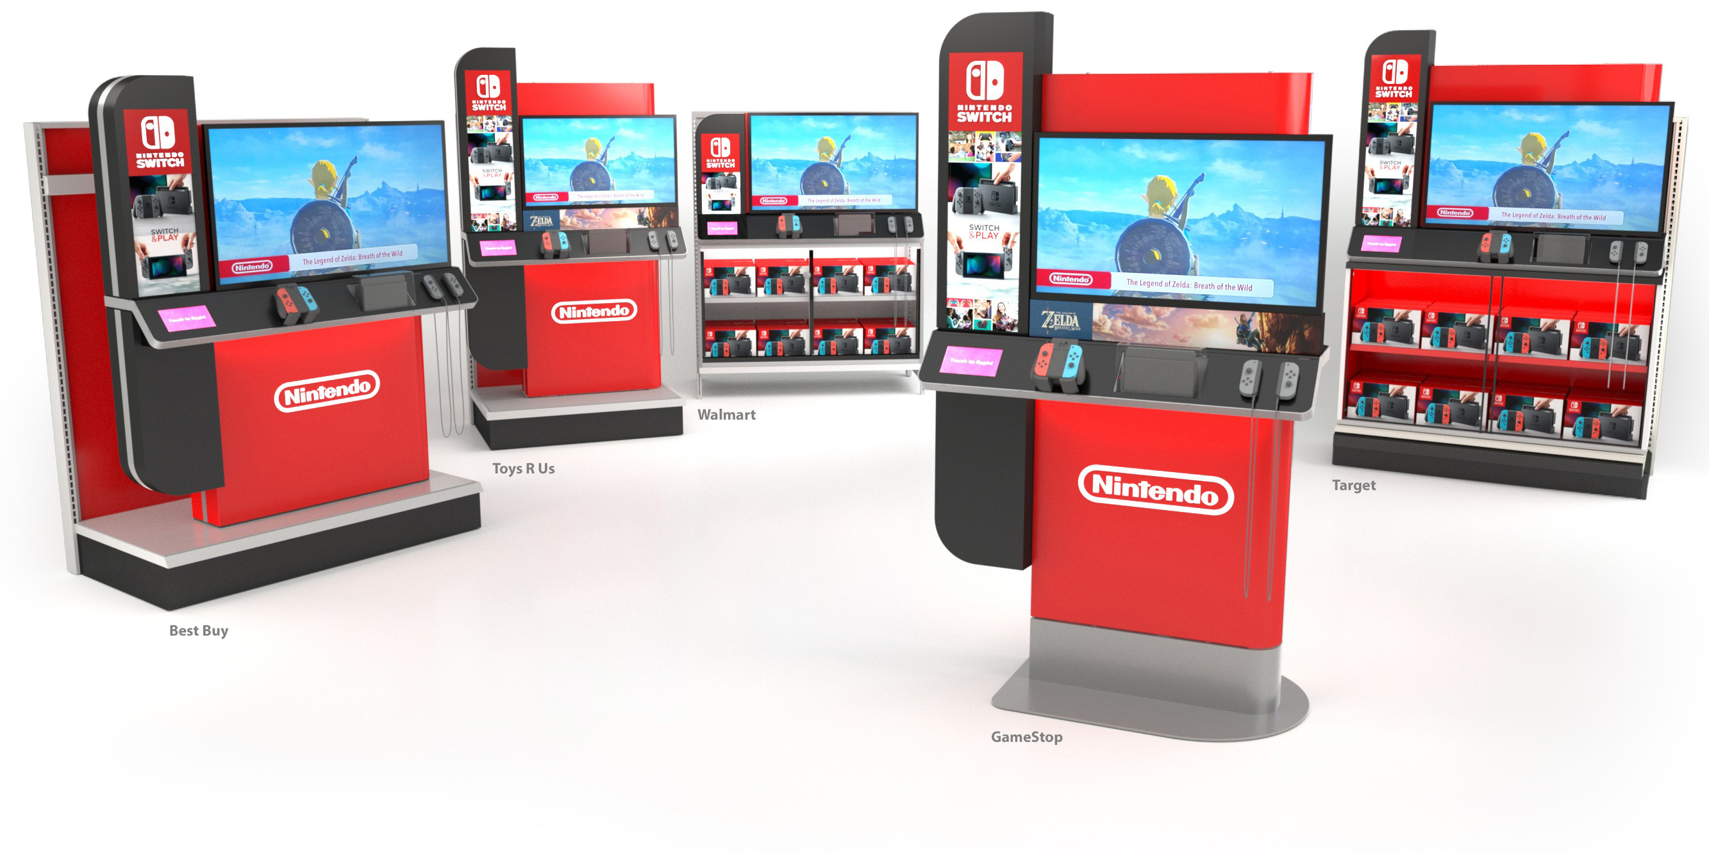

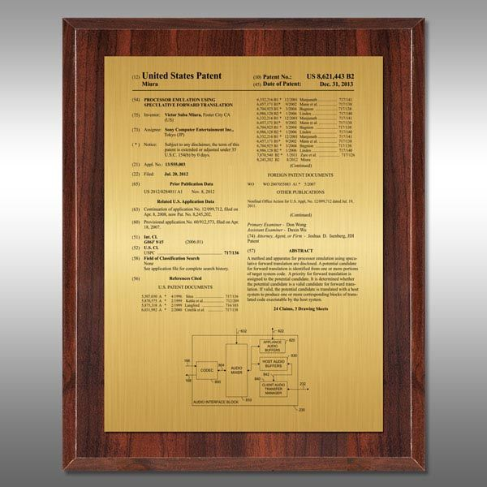
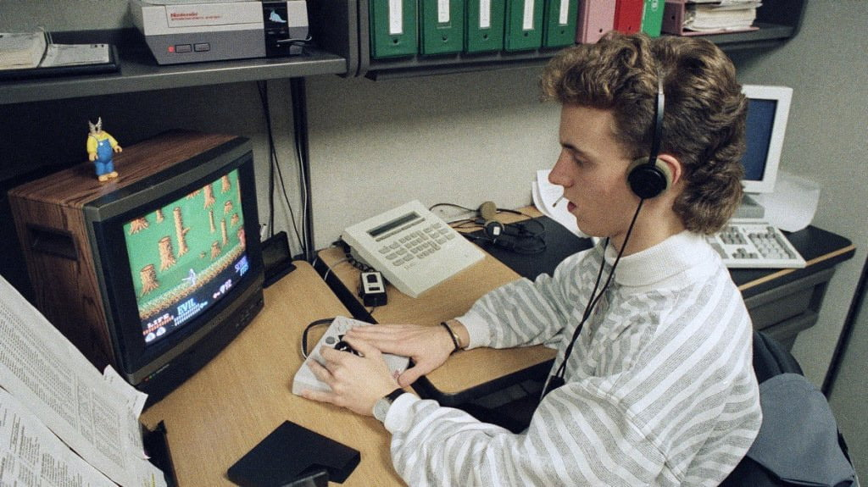
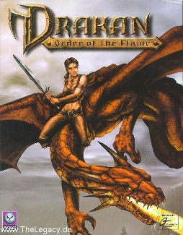
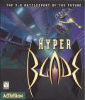
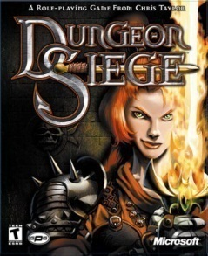

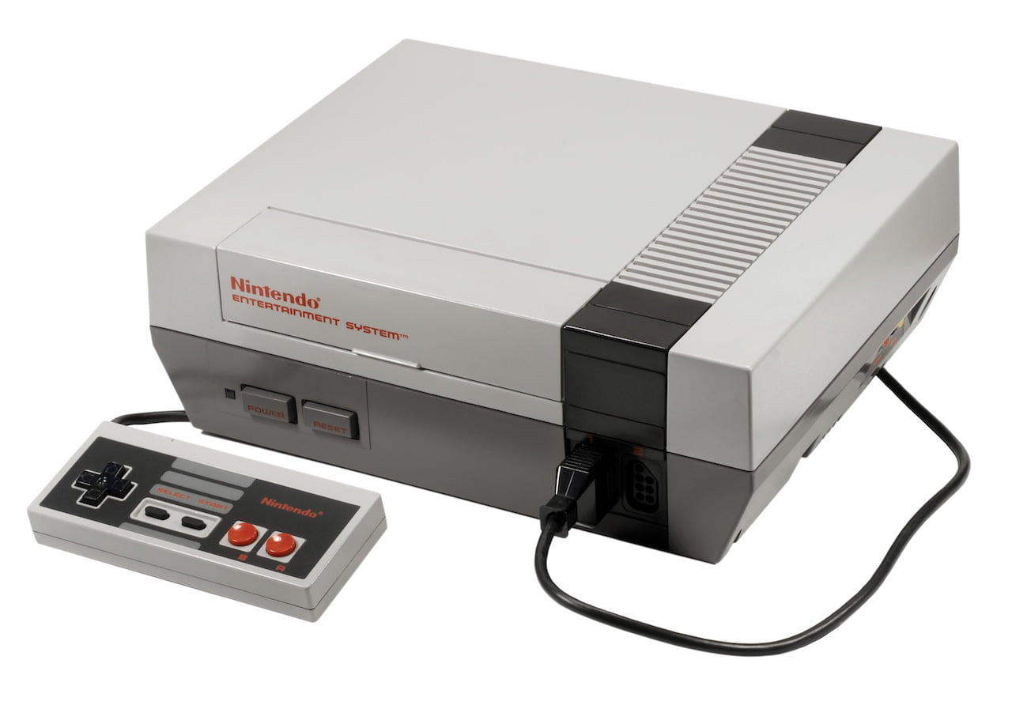
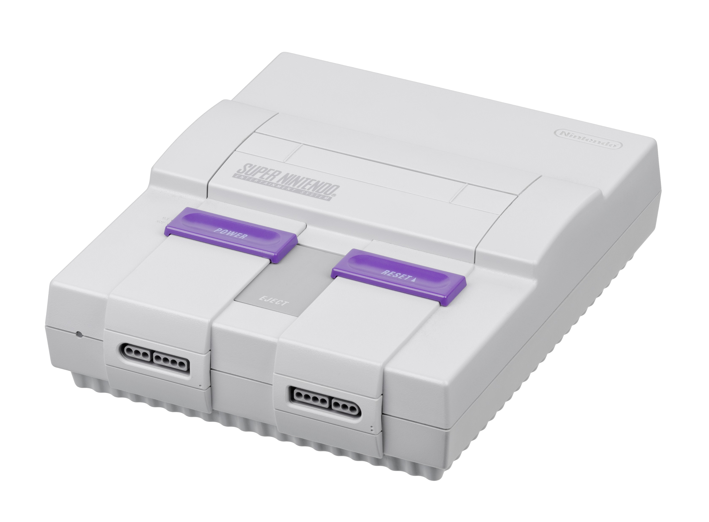
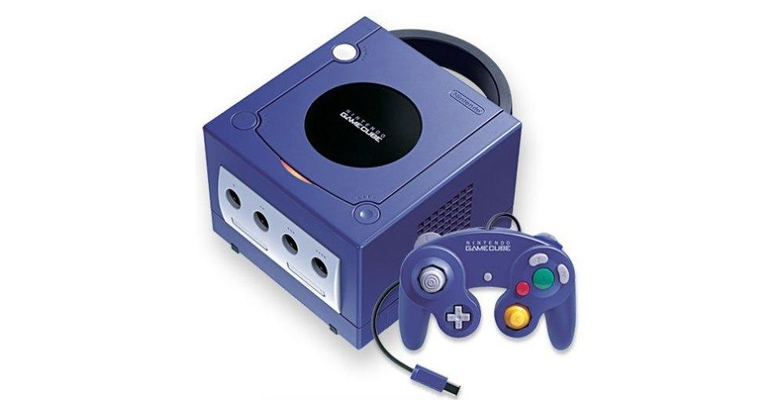




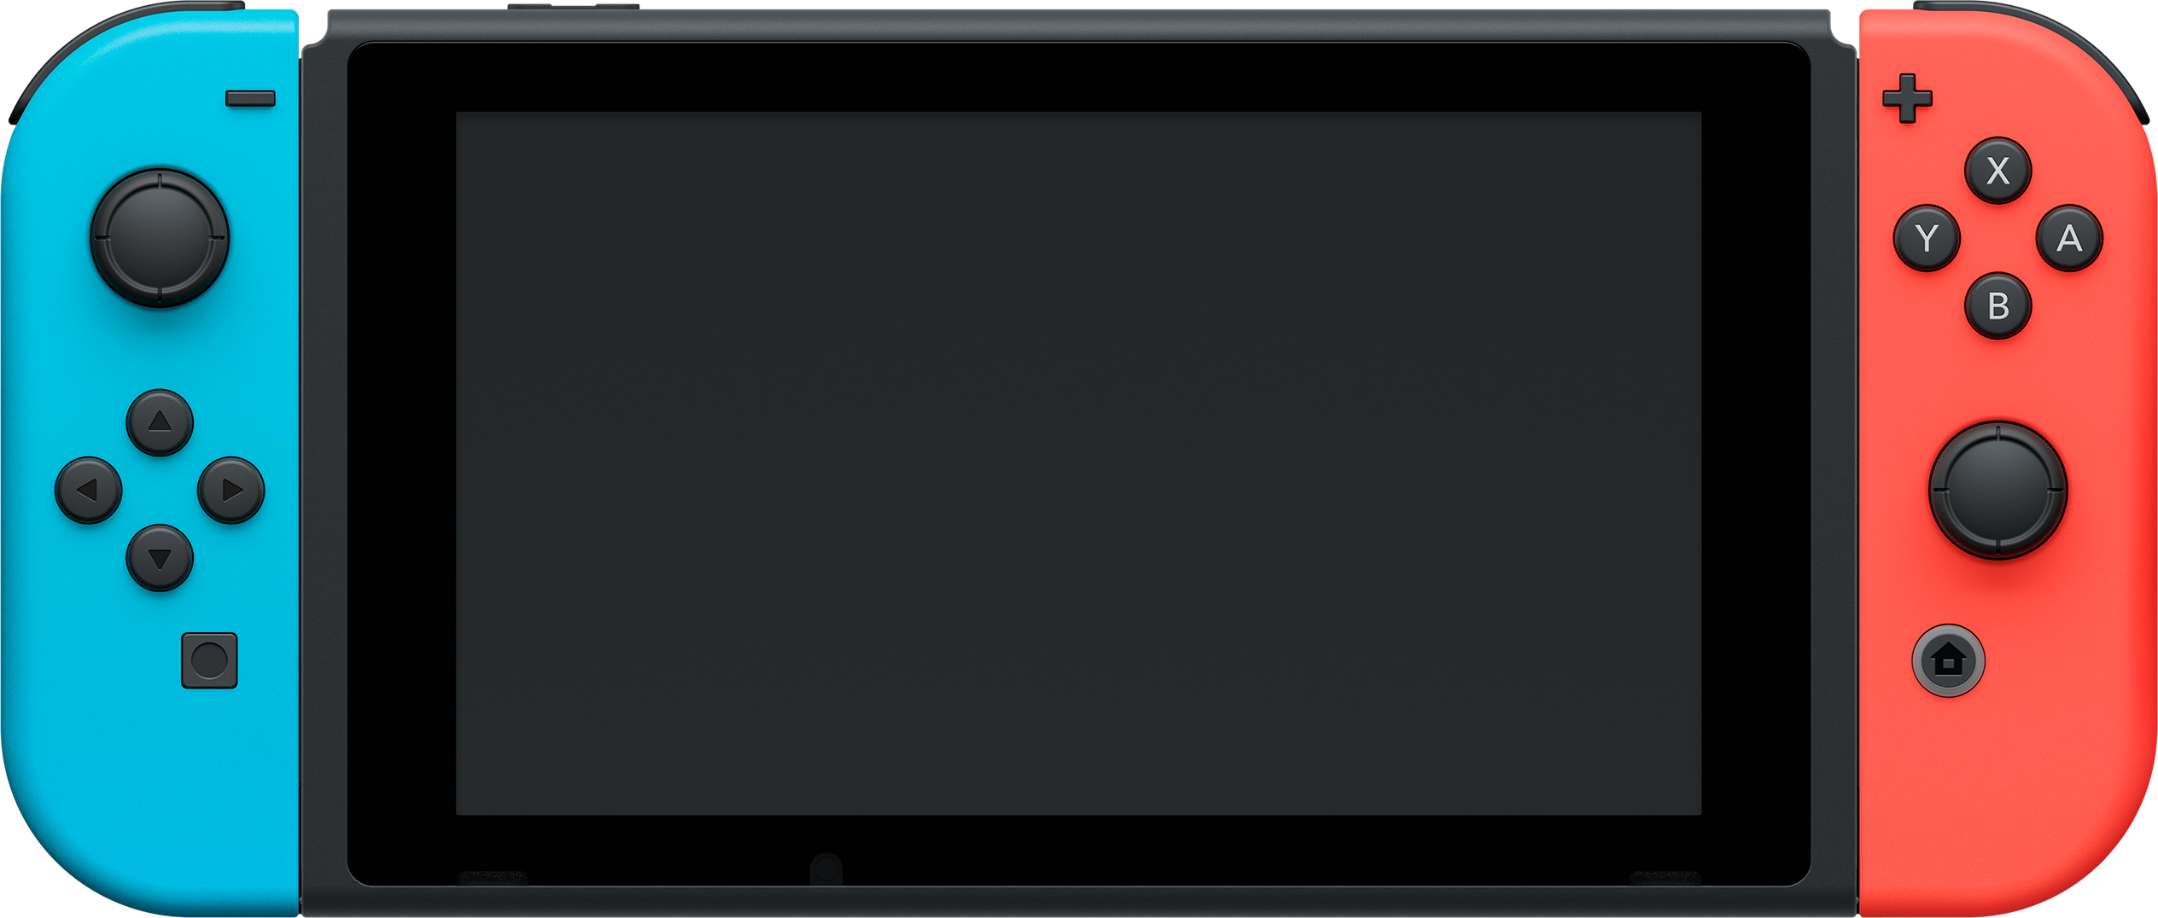






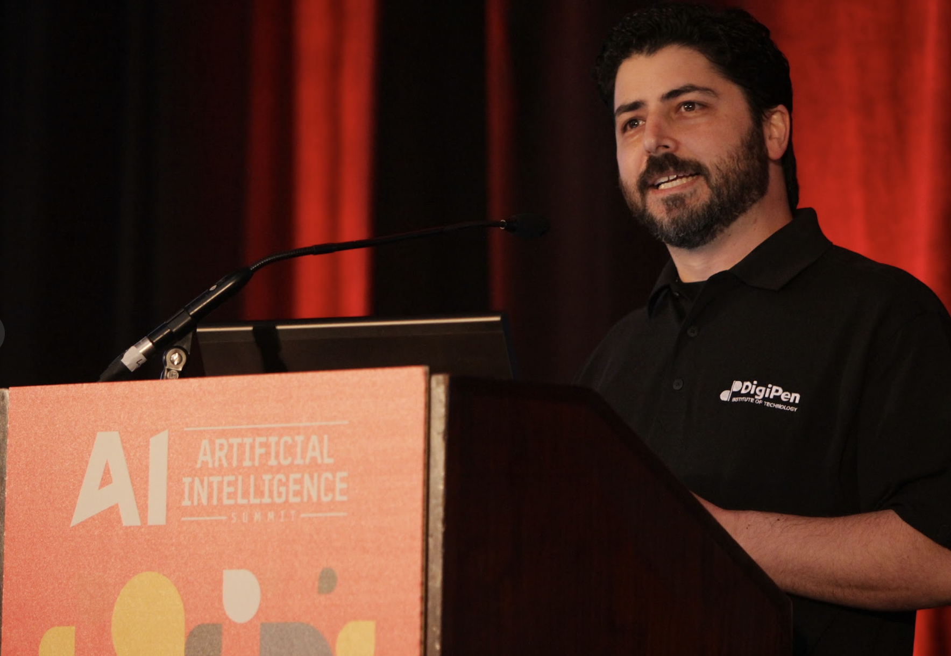









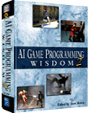
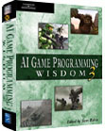
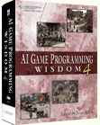



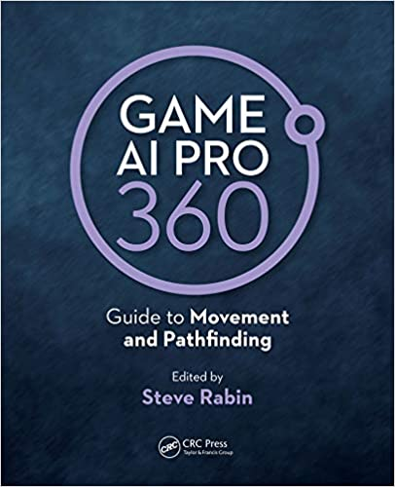
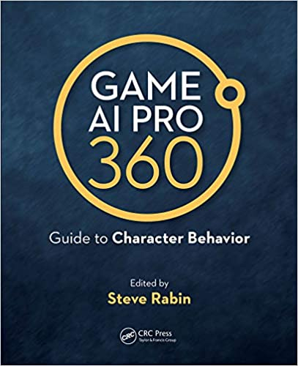

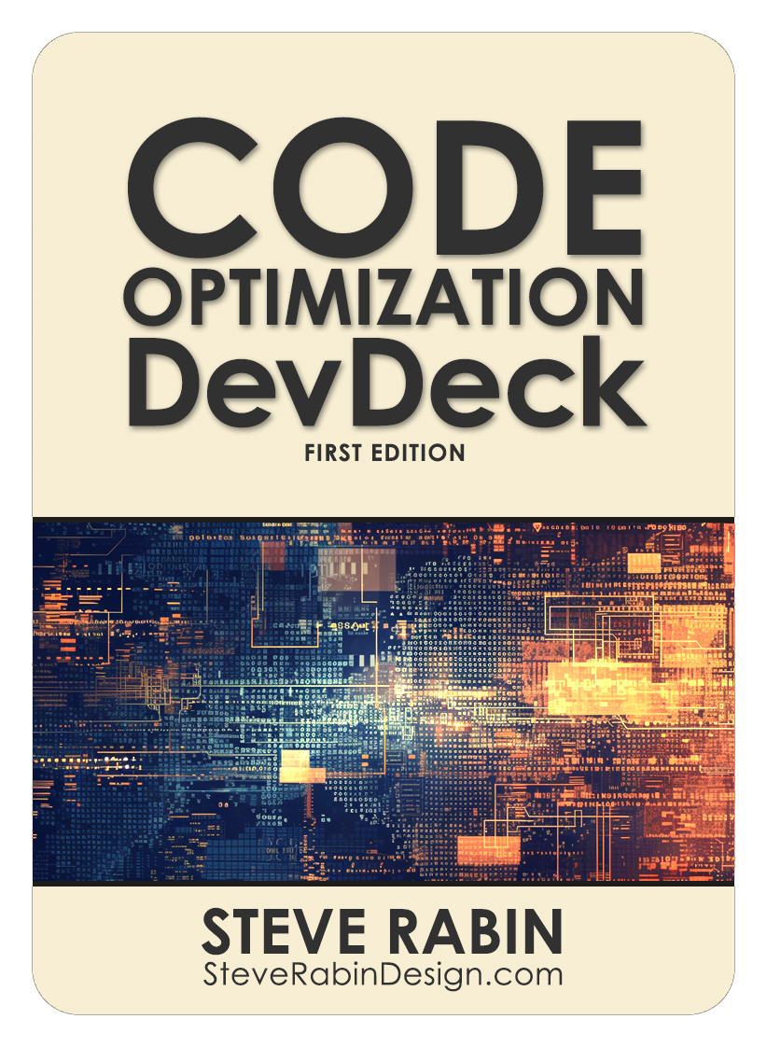

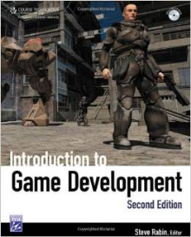
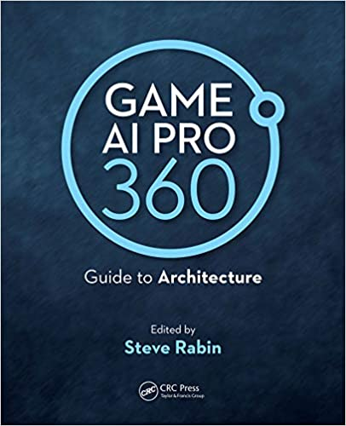
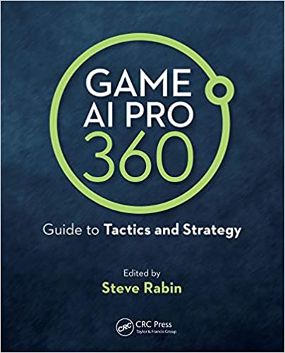


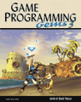





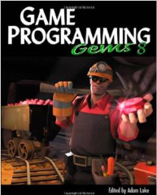



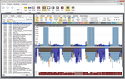

100,000
UX
Technology
Development
1990
1996
2000
2006
2009
2017
2024
Masters
Steve Rabin
Design
Book Editing & Writing
Teaching

Slide 3
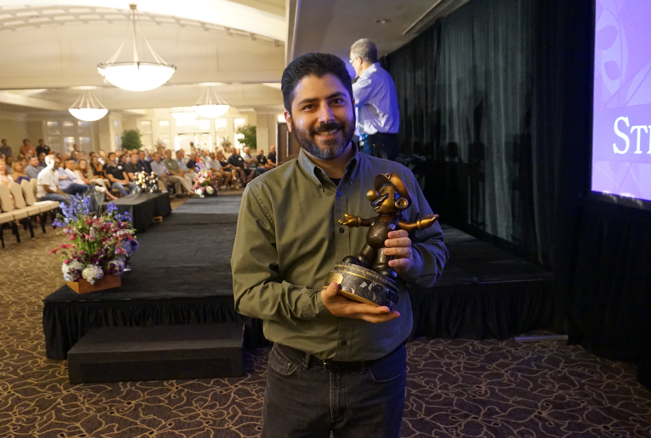
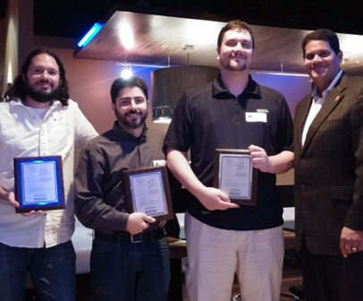
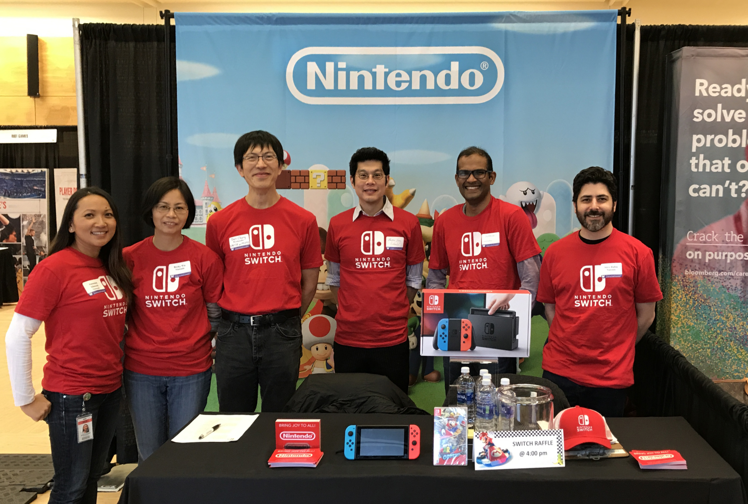

Slide 4
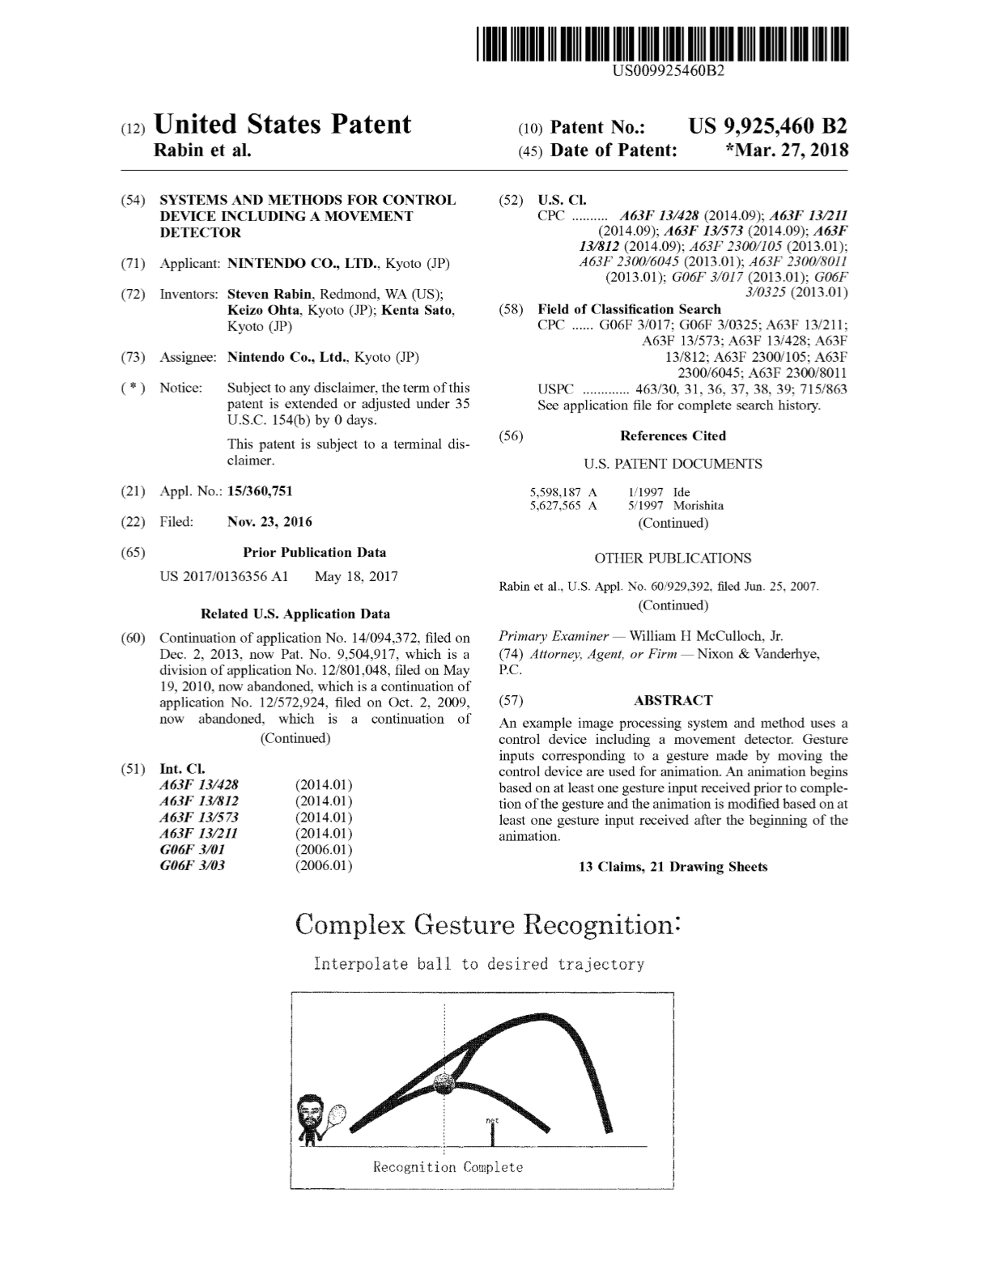

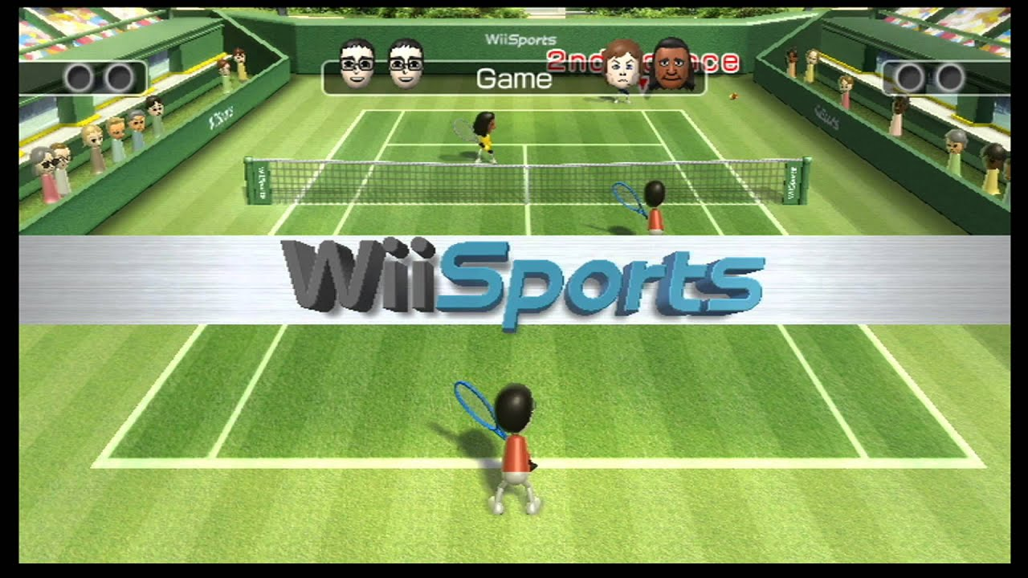

Slide 5
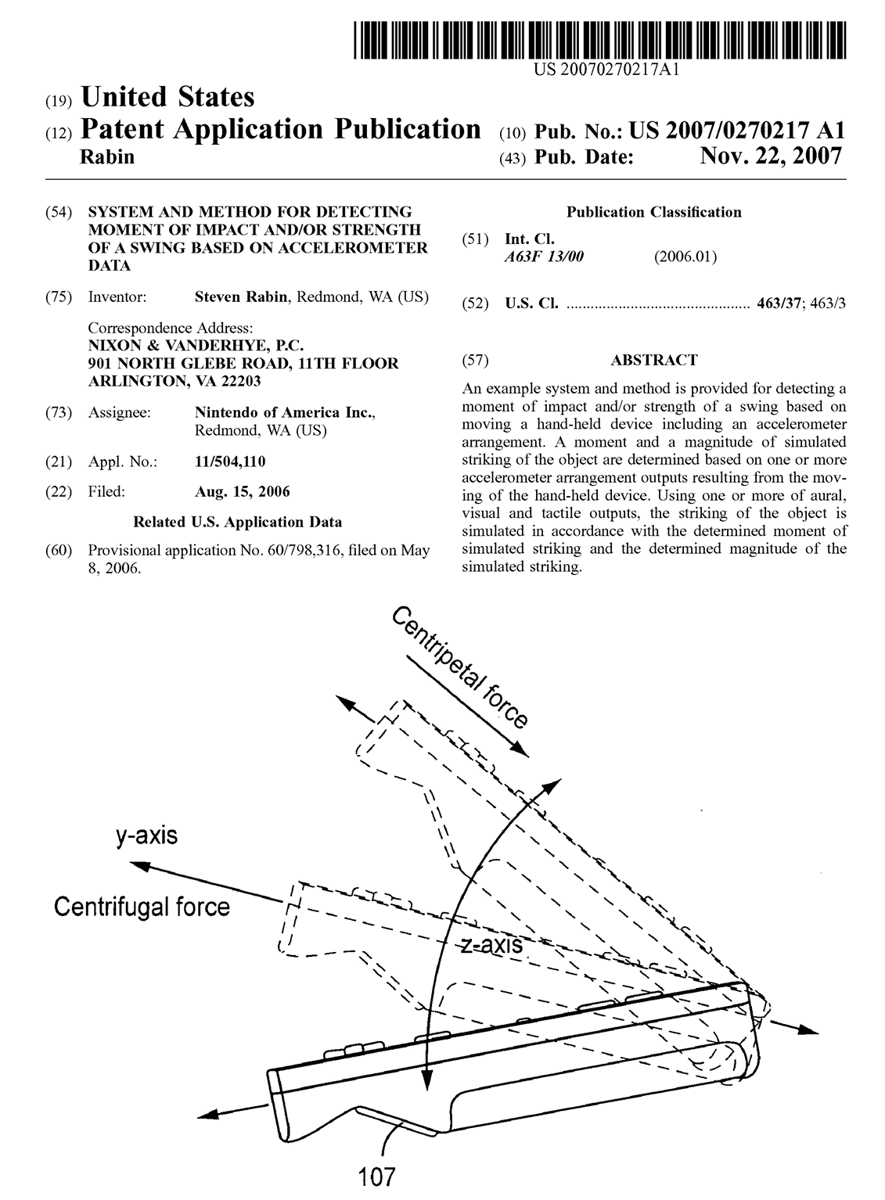


Slide 6
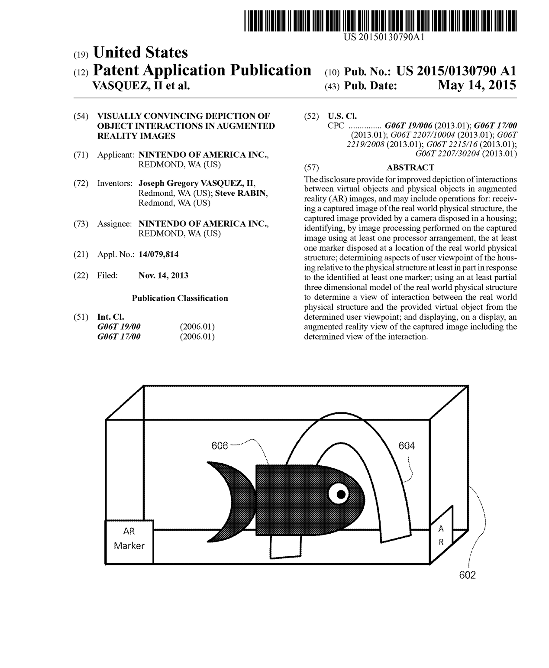

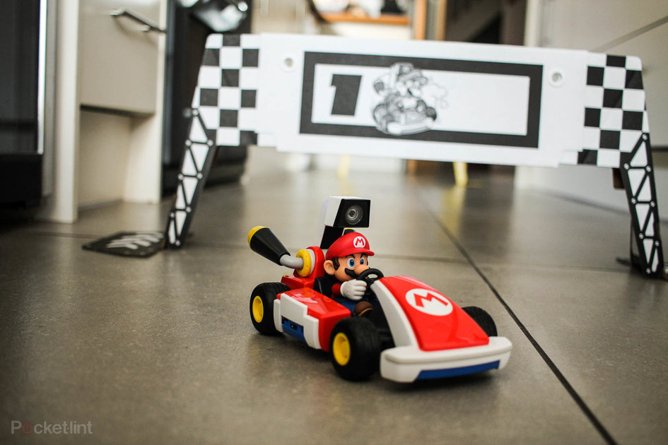

Slide 7
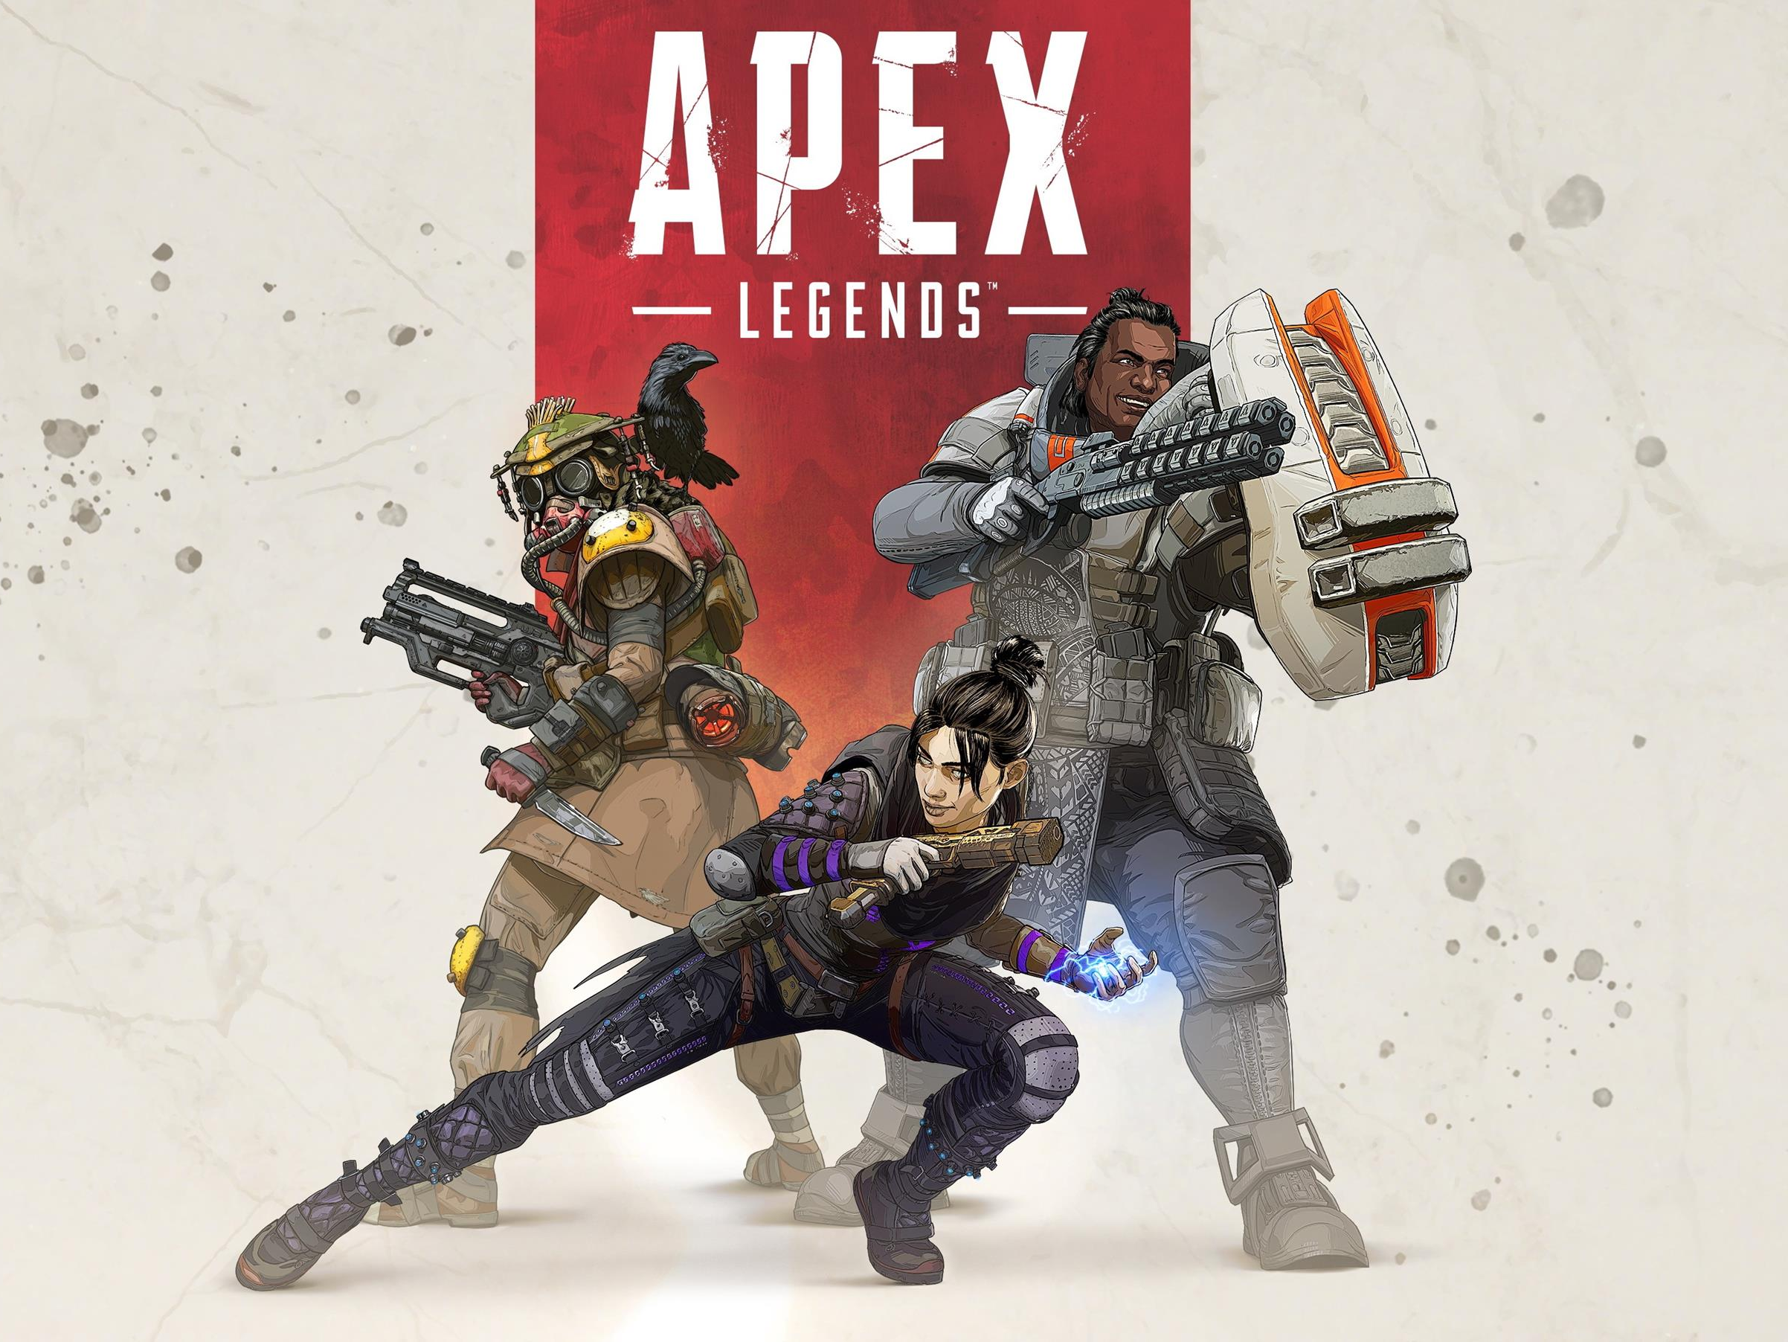

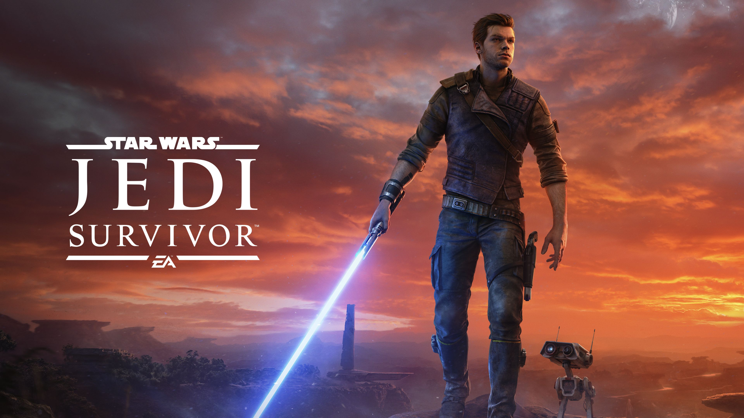

Slide 8




Class Books
Find these for free at gameaipro.com
Online
Edition
2021

Slide 9
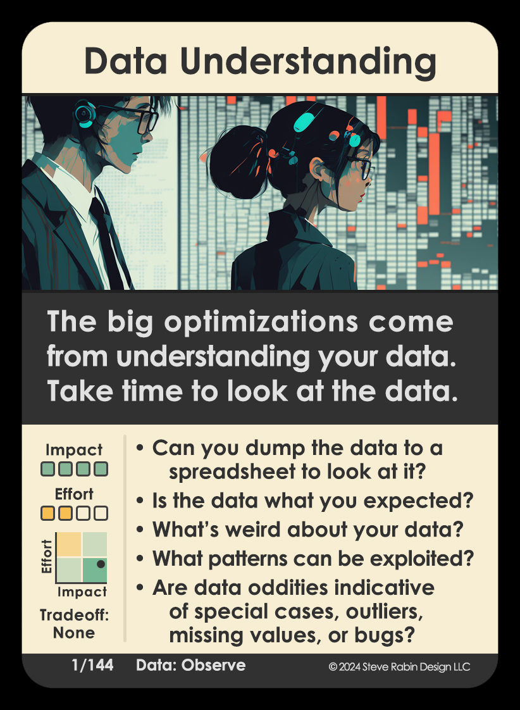

Slide 10
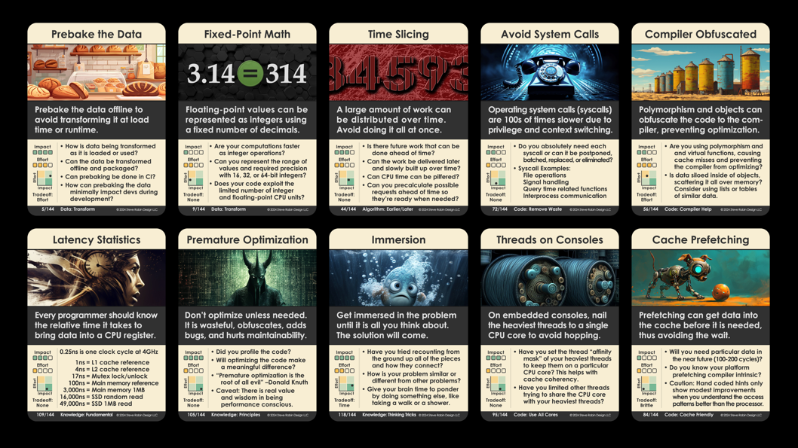

Slide 11
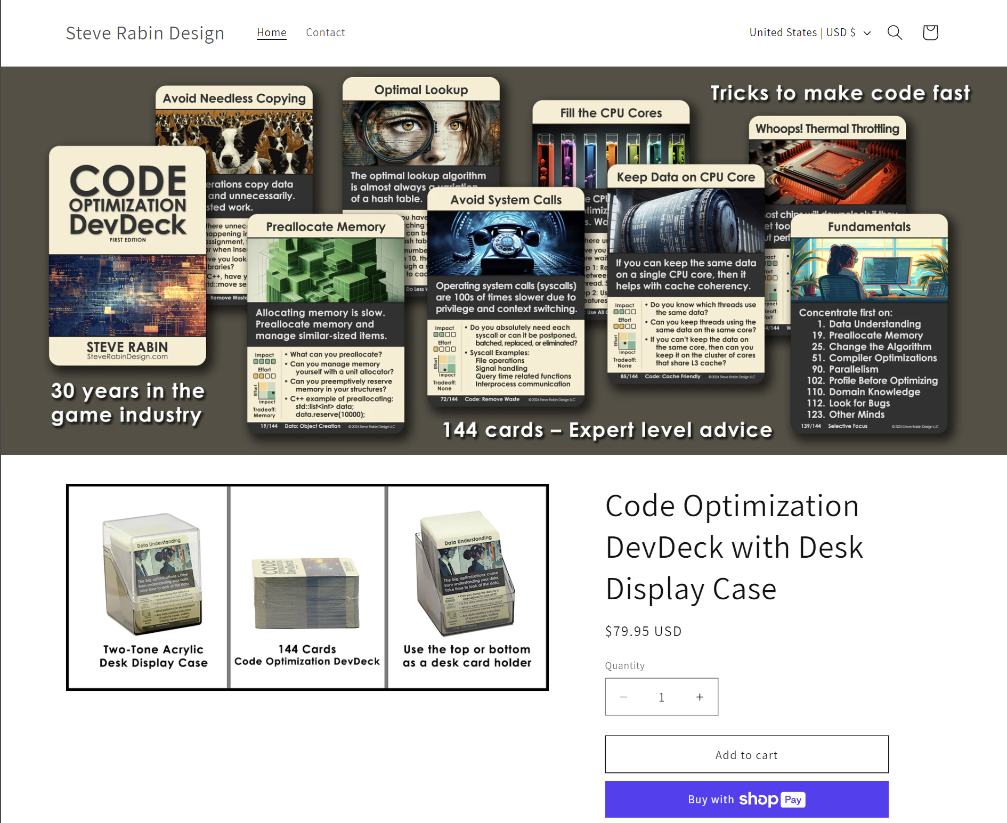

Slide 12
Hours per Week (average of 3 Semesters)

Slide 13
Hours Spent
Project 1: Behavior Trees
Median of 12 hours
Project 2: Pathfinding
Median of 20 hours
Project 3: Terrain Analysis
Median of 12 hours

Slide 14

Grade breakdown
5% Written Paper “10 Things I Hate About Your AI” (due week 2)
15% Project 1 Behavior Trees (assigned week 2, due week 4)
15% Project 2 A* Pathfinding (assigned week 4, due week 7)
15% Project 3 Terrain Analysis (assigned week 7, due week 9)
25% Research Project Presentation/demo week 14, paper week 15
25% Final Exam ~8 Page fill-in-the-blank, multiple choice, work algorithm

Slide 15
Do not come to class sick!
If you feel off or not right for any reason, do not come to class.
There is NO penalty for not coming to class.
Class slides are posted before every lecture.
Class lectures will be recorded and shared on an as-needed basis in case of absence. It is against DigiPen policy to stream this class.

Slide 16

Turning in projects
Written Assignment (5%)
Project 1: AI Architecture (15%)
Project 2: A* Pathfinding (15%)
Project 3: Terrain Analysis (15%)
Submit projects through Moodle
Due date is before class
Late projects will be penalized
10% penalty for every 24 hours late (71.99 hours late = -30%)
Extra credit offered
Only as extensions of the three projects

Slide 17
Research Project
Research a game AI topic of your choice
Code demo that shows concept
Presentation is 10 minutes (explanation & demo)
Research paper (5+ pages in style of Game AI Pro article)
Graduate students 10+ pages, graded at professional level
25% of grade
8% demo, 8% presentation, 8% paper, 1% proposal
Postponed demos/presentations penalized by 10% per day

Slide 18
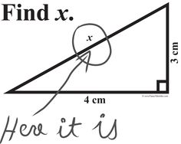
Final
8 page Final (25%)
Fill-in-the-blank, Multiple choice
Draw a picture, Work an algorithm
Week 15:
Practice final will be posted on last day of class

Slide 19
Academic Dishonesty Policy
Academic dishonesty, or cheating, occurs when a person represents someone else’s work as their own or assists another person in doing so.
All solo coding projects are to be done individually with absolutely no collaboration. It is prohibited to show code to each other. It is prohibited to receive coding or debugging help from other students (past or present). It is prohibited to provide coding or debugging help to other students. Assisting others in cheating is prohibited and will be equally punished.
Copying any code or pseudocode from any source, including current or past student projects, online sources, or books is prohibited. Looking at current or past student project code is prohibited, as well as looking at any past CS380/CS580 final exams. Copying or cheating on the final exam is prohibited as well as assisting in copying or cheating. Plagiarizing text on the research paper is prohibited.

Slide 20
Academic Dishonesty Policy
Violating these rules is considered academic dishonesty and will result in immediate failure from the class and being reported to the DigiPen administration for further disciplinary action.
If at any point you are unsure at all if an action would be considered academic dishonesty by the instructor, please email the instructor for clarification before you take the action. If you need assistance with any coding project, contact the TA and/or the instructor.

Slide 21




Violations get reported to:
Professor Volper
CS Masters
Program Director
Professor Beeman
Game Development
and Production
Professor Amayri
CS Dept Chair
Professor Pushpak
CS Program Director

Slide 22
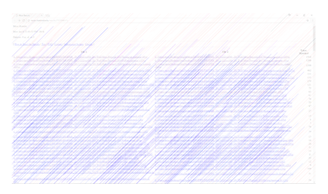
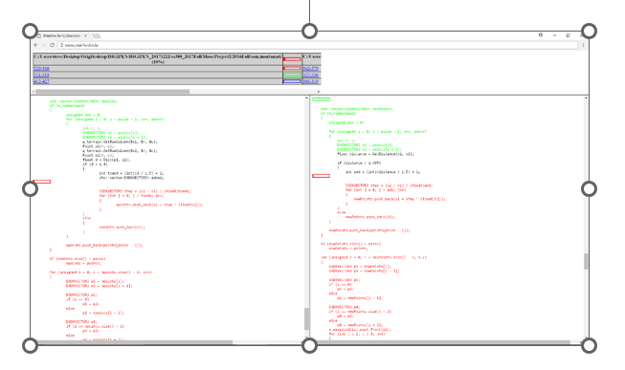
Stanford’s MOSS

Slide 23
Stanford MOSS Similarity Scores
Project 2 in a previous semester
(scores are a clue and low percentages still had significant copying when hand analyzed)
Student 6
67%
94%
Student 7
67%
Student 8
Student 9
85%
66%
2%
Student 1
Student 10
Student from previous semester
Student 11
<1%
2%
65%
Student 2
Student 12
14%
Student 13
13%
68%
56%
Student 3
9%
Student 14
37%
Student 15
Student 5
5%
48%
12%
5%
6%
Student 4
Student 16
5%
Student 17
2%
Student 18

Slide 24
Week | Monday | Wednesday
1 | History of Game AI + Written assigned | History of Game AI
2 | AI Architecture 1 | AI Architecture 2 + Project 1 assigned
3 | NO CLASS | Movement 1
4 | Movement 2 | Pathfinding 1 + Project 2 assigned
5 | Pathfinding 2 | Pathfinding 3
6 | Terrain Analysis | NO CLASS + Project 3 assigned
7 | Agent Awareness | Pathfinding 4
8 | Company of Heroes/FEAR | Procedural Content Generation + Research assigned
9 | Indirect Adaptation | Indirect Adaptation
10 | Direct Adaptation | Direct Adaptation
11 | Randomness | GDC Presentations
12 | Final Exam

Slide 25
Written Assignment due Wed, May 22nd (TURN IT IN OR GET DROPPED)
Step 1:
Watch this 27min GDC talk: “30 Things I Hate About Your Game Pitch”
(https://www.youtube.com/watch?v=4LTtr45y7P0)
Step 2:
Brainstorm a list of “Things I Hate About Your Game AI”.
Research terrible game AI and what people are complaining about. Add to your list.
Step 3:
Decide on 10 to write about. Your title is “10 Things I Hate About Your Game AI”.
Each item needs a descriptive title header, like “Getting shot in the back is not fun”.
Each item must have 4 to 8+ sentences explaining:
1. What is the thing you hate (or your “beef”).
2. Why you hate it.
3. One or more examples from a real game.
4. (optional) Provide a solution.
Note: Points deducted for incomprehensible writing, poor grammar, and/or spelling mistakes.

Slide 26
Homework due next Wed, May 22nd
Turn In
Electronic document in Moodle.
Submit a Word doc (you must use the template).
No late submissions on this HW.

Slide 27
What is game AI?

Slide 28
In-class activity
Write down your own definition of “Game AI”

Slide 29
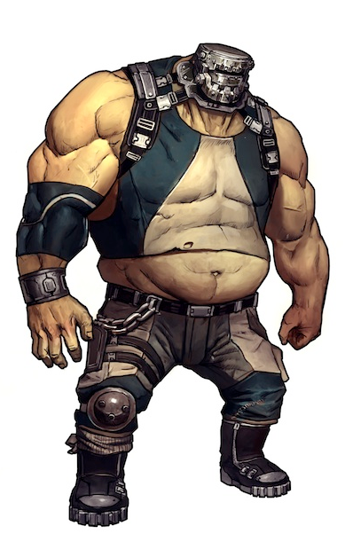

NPCs come in many forms
Adversaries
Enemies (individuals, factions)
Opponents
Neutral characters
People (sentient individuals, factions)
Wildlife (creatures, ambiance)
Cooperative characters
Squad members
Teammates (FIFA, Madden)
Buddies

Slide 30
But what do they do? What is the game AI?
Sense
See and hear (in the moment)
Remember info
Current state (hurt, tired, hungry, angry, scared)
Think
Intelligent decisions (choose best option/move)
Learning and adaptation
Act
Manipulate objects
Manipulate body
Reactive and planned movement
Complex animation
Verbal or gestures
“Behavior”

Slide 31
Let's push our understanding of game AI

Slide 32
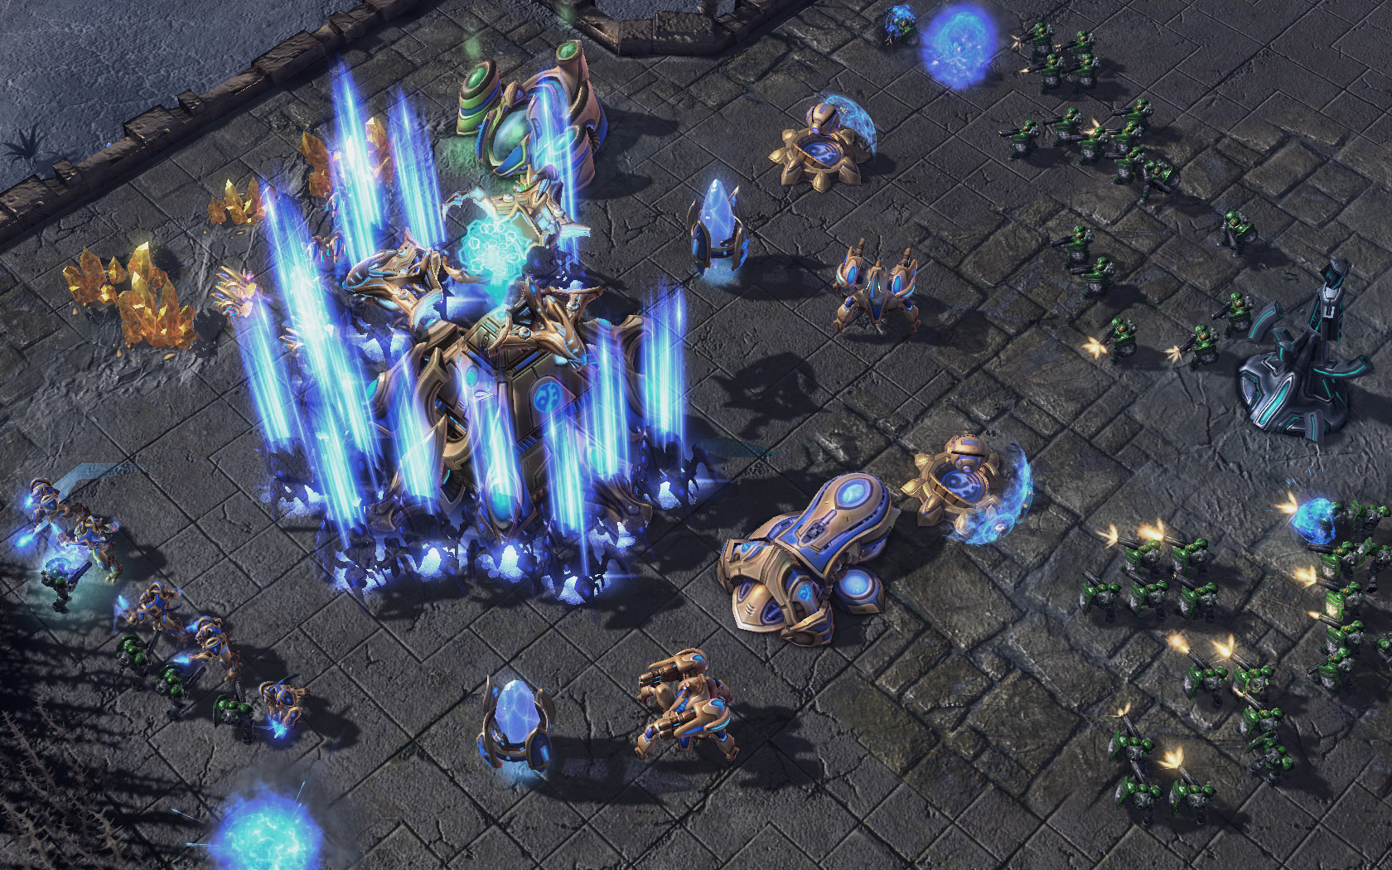
NPC strategy in an RTS?

Slide 33
Choosing a random strategy?

Slide 34
What if the strategy is always the same?

Slide 35
What if the strategy is a script?

Slide 36
What if the strategy script is non-branching?

Slide 37
What is considered game AI? Do these things matter?
Deterministic vs Random
Picking a random move?
Reactive vs Non-reactive
Ignoring the player and always doing the same thing?

Slide 38
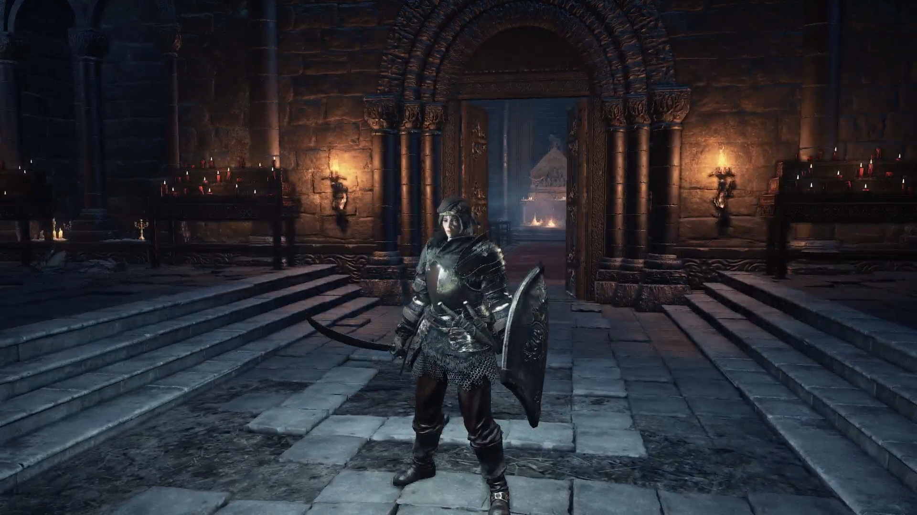
Finding a path through a dungeon?

Slide 39
Intercepting the player?

Slide 40
Moving toward the player?

Slide 41
Selecting a “walk” or “limp” animation?

Slide 42
Selecting a random idle animation?

Slide 43
What is considered game AI?
Are both of these AI?
Complex movement
Simple movement
Is choosing animations AI?
Based on status
Based on movement speed
Based on randomness

Slide 44
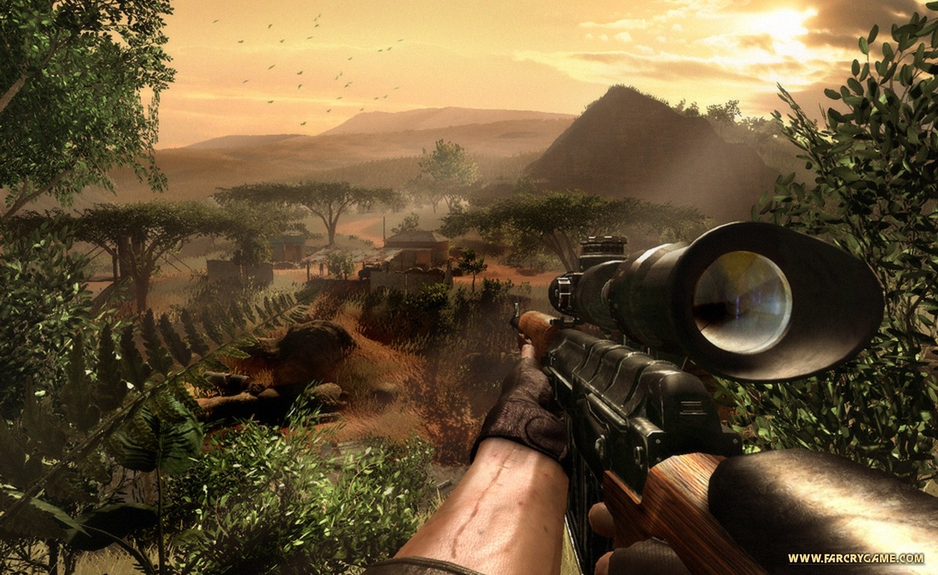
NPC hides from player?

Slide 45
NPC sees player? (line-of-sight test)

Slide 46
NPC retreats? (single "if" statement)

Slide 47
What is considered game AI?
Are collision tests AI?
Line-of-sight
Isn't this the physics engine?
Is looking up the player’s location “sensing”?
Is a single "if" statement AI?
if( health < 10 ) { Runaway(); }

Slide 48
In-class activity
Write down your own definition of “Game AI”
Write down a modified definition (second pass)

Slide 49
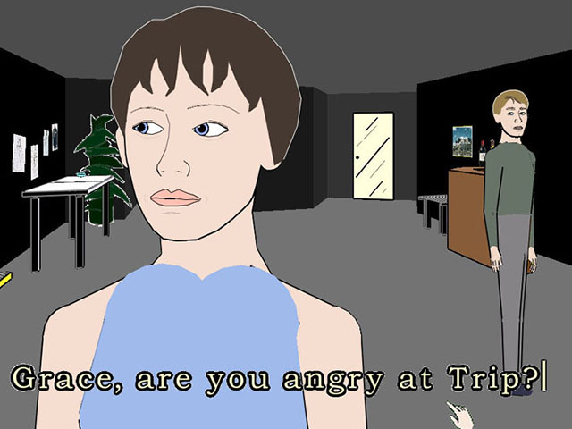
Is an interactive story game AI?

Slide 50
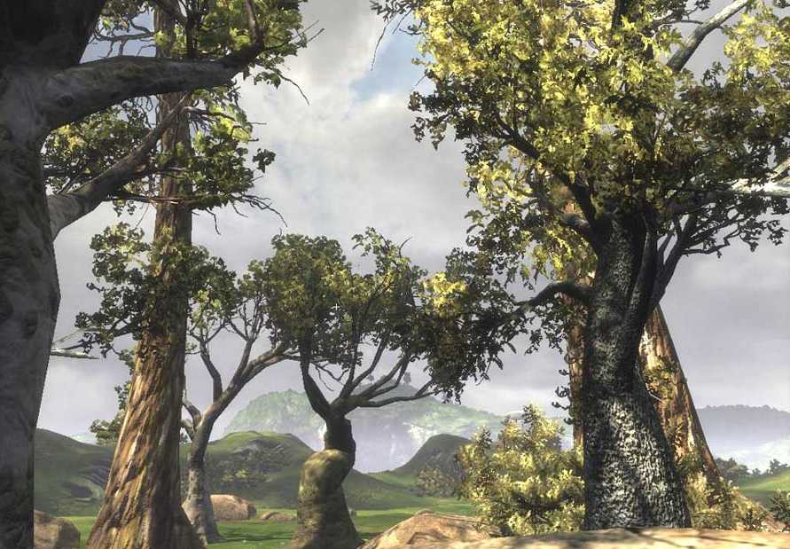
Auto-generated trees?

Slide 51
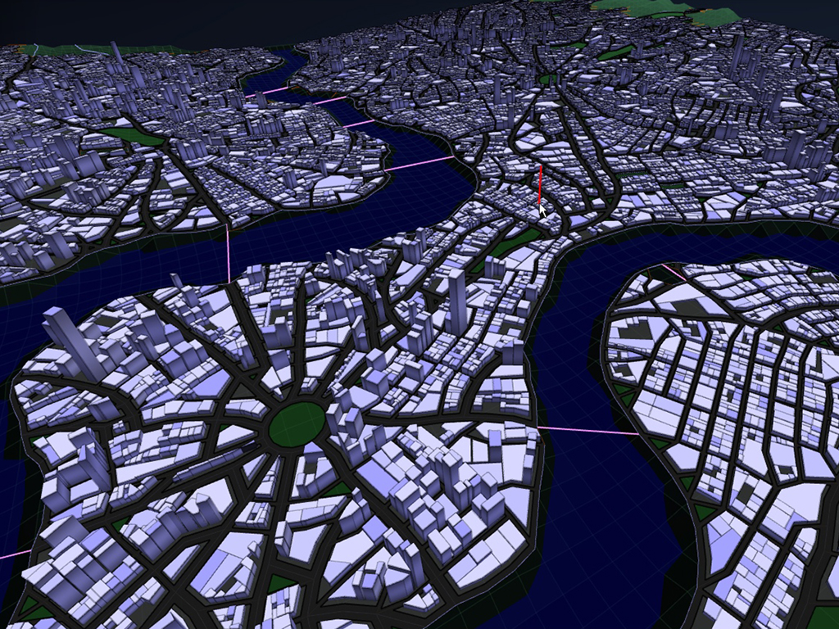
Auto-generated cities or dungeons?

Slide 52
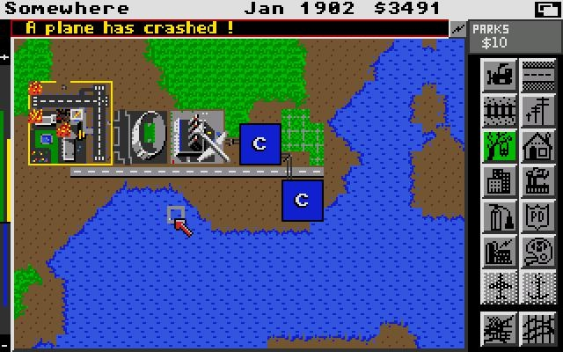
Auto-generated with a PRNG?

Slide 53
What is considered game AI?
Is an interactive story AI?
Who’s writing the story?
Is an auto-generated tree/map game AI?
Are trees and maps really NPCs?
Is a tree intelligent?
Is the tree or map’s creator intelligent?
Is inferring player intent game AI?

Slide 54
Wikipedia definition of game AI
“Techniques to produce the
illusion of intelligence in
the behavior of NPCs”

Slide 55
Extra add-on definitions
Techniques to automatically generate game content
(at runtime or offline)
Techniques to detect player’s intent or what they are doing

Slide 56
Further analyze game AI

Slide 57
Player
Actions
AI
Architecture
Game
Design
Movement &
Pathfinding
Scripting
Physics &
Collision
Animation

Slide 58
Goals of an AI programmer
Different than academic or defense industry
1. AI must be intelligent, yet purposely flawed
2. AI must have no unintended weaknesses
3. AI must perform within the constraints
4. AI must be configurable by game designers or players
5. AI must not keep the game from shipping
6. AI must be entertaining and challenging

Slide 59
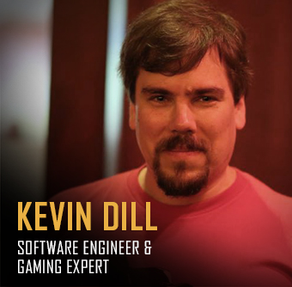
Game AI = human authored behavior
“Human authored behavior is the absolute right answer in this domain.”
“In some ways, I think that we’re not really in the business of building AI, we’re in the business of building domain-specific, highly customizable, carefully constrained programming languages.
What we do is find better ways to enable humans to define how the computer should behave, which is fundamentally what programming is... and we as a community – game AI specifically – have led the charge in that domain for 2-3 decades now, and have made *enormous* strides along the way.
Hell, the military simulation industry is only now figuring out things that we did 10+ years ago (like behavior trees). For instance.”

Slide 60
Insight: AI as game design
Implementation of AI impacts game design
Creates opportunities for player
Player learns to manipulate the AI
(not just defeat it)
Designer / AI programmer relationship
Close collaboration required
Understand each other’s abilities and constraints
Might be most important issue
~50% of GDC 2008 AI roundtable participants

Slide 61
Insight: Intelligence is context-dependant
Don’t need general intelligence
Key: Narrow down the domain until it’s doable

Slide 62

Insight: Need many different techniques
“My opinion is that we can make versatile AI machines only by using several different kinds of representations in the same system! This is because no single method works well for all problems…”
– Marvin Minsky, MIT

Slide 63
Insight: Every game requires different AI
Consider different genres
FPS
RPG
RTS
Sports
Racing
Fighting
Result:
Considerable specialization within AI
One reason why AI middleware is so difficult

Slide 64
Insight: AI coders are like interior designers
A homeowner wants their house decorated
They have vague ideas that aren’t articulated well
They’ll know it when they see it
A game designer wants the game characters decorated with behavior
They have vague ideas of how the behavior might work
They’ll know it when they see it
AI Programmer’s job is to work with the game designer
Suggest possibilities
Work with designer to get at what designer really wants

Slide 65
Insight: Game AI is entertainment
Beating the player is not the goal
The player feeling challenged and having a good time is the goal
The AI doesn’t have to solve the hard problem of intelligence
Cheating is OK
“If you ain’t cheating, you ain’t trying. If you get caught cheating, you ain’t trying hard enough”
The AI needs to give a performance
The AI is like an actor who plays a part and gives a performance
The AI should give (fake) clues so that it is perceived as being more intelligent

Slide 66
Readings for next week (by Monday)
www.gameaipro.com
GAIP 1, Ch 1: What is Game AI?
GAIP 2, Ch 1: Game AI Appreciation, Revisited
GAIP 1, Ch 5: Structural Architecture
GAIP 1, Ch 9: An Introduction to Utility Theory

Slide 67
Written Assignment due Wed, May 22nd (TURN IT IN OR GET DROPPED)
Step 1:
Watch this 27min GDC talk: “30 Things I Hate About Your Game Pitch”
(https://www.youtube.com/watch?v=4LTtr45y7P0)
Step 2:
Brainstorm a list of “Things I Hate About Your Game AI”.
Research terrible game AI and what people are complaining about. Add to your list.
Step 3:
Decide on 10 to write about. Your title is “10 Things I Hate About Your Game AI”.
Each item needs a descriptive title header, like “Getting shot in the back is not fun”.
Each item must have 4 to 8+ sentences explaining:
1. What is the thing you hate (or your “beef”).
2. Why you hate it.
3. One or more examples from a real game.
4. (optional) Provide a solution.
Note: Points deducted for incomprehensible writing, poor grammar, and/or spelling mistakes.

Slide 68
Homework due next Wed, May 22nd
Turn In
Electronic document in Moodle.
Submit a Word doc (you must use the template).
No late submissions on this HW.

